Slide 1
Serving Student with Disabilities

Slide 2
What skills are required in Science that may be difficult for students?
Physical Components
.
Memory/
Reading Visuals

Slide 3
What skills are required in Science that may be difficult for students?
Vocabulary/
Reading
Inferencing
Physical Components
.
Literacy Skills
Organizing Information
Listening
Comprehension
Memory/
Reading Visuals

Slide 4
What is the Difference? How do we Adapt Instruction?
Modifications | Accommodations | Strategies
The expectation or outcome is altered | Designed to level the playing field without giving a student an advantage | An approach a teacher uses to deliver content.
A student is given extended time on a test
A word bank is used on an assessment and provided to only one student
Annotation marks are used/modeled during a reading activity

Slide 5
Physical Aspects
Physical Components
Physical tasks are an important part of many science lessons, from taking soil samples, mixing chemicals, using Bunsen burners, recording data, and performing dissections. This type of physical work can present significant barriers for many students with disabilities —
dysgraphia,
poor motor control,
emotional/behavioral disorders,
orthopedic disabilities,
cognitive impairments
Visual impairments
How can we make adaptions?

Slide 6
Office 365-Dictation
Physical Components

Slide 7
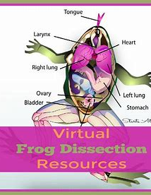
Virtual Experiences
Physical Components
Fieldtrips
Dissections
Visuals

Slide 8
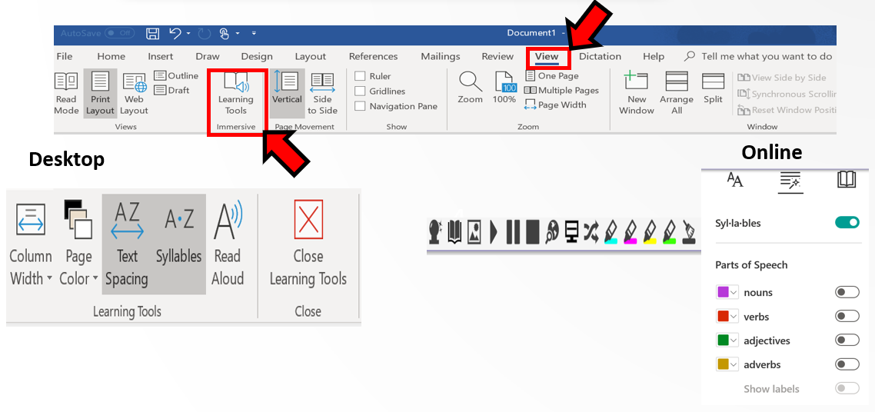
Office 365-Immersive Reader
Reading/
Vocabulary

Slide 9
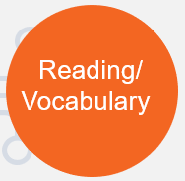
Spot Dot Divide
Decoding Words

Slide 10
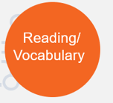
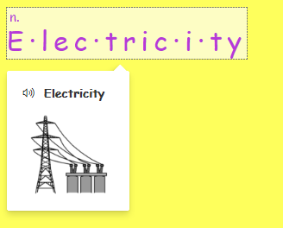
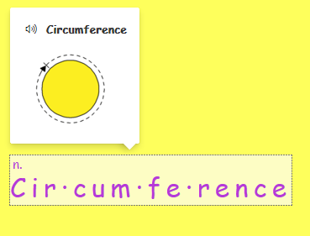
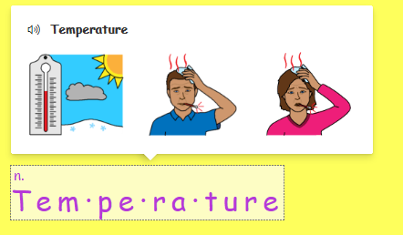
Syllable Feature in Microsoft Word
In Microsoft word, type the vocabulary words on a document.

Slide 11
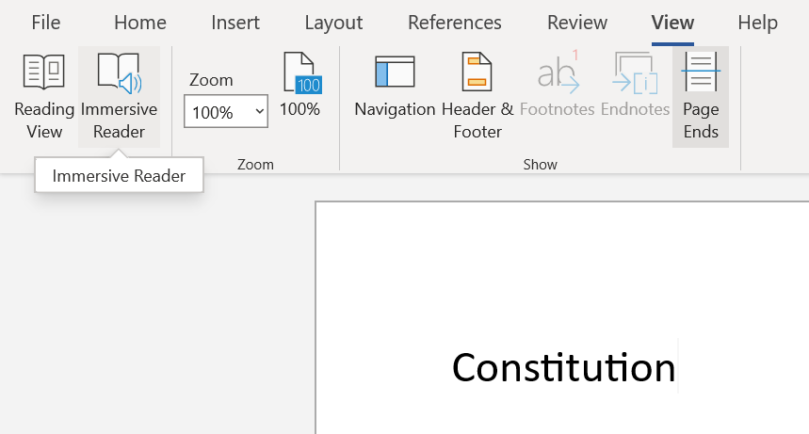
Direction for using the Syllable Feature in Word
Step 2: Go to View
Step 3: Immersive Reader
Step 1: Type the word
Organism
Step 4: Click the line visual to turn the syllable feature on

Slide 12
Visual Dictionary

Slide 13
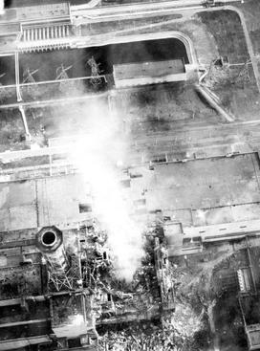
Inferencing & Science
Inference:
Why might the smoke be dangerous?
What is burning?
What do you think happened?
Where is most of the damage in the building?

Slide 14
Using Text to Support Inferencing!
Can you answer any factual questions that will lead to making inferences:
What
When
Where
Who
Why would radiation in the air affect people all over the world?

Slide 15
Supporting Classroom Notes

Slide 16
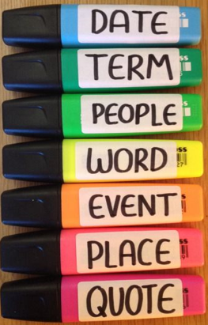
How do you highlight?
Do not use one single-color highlighter
Assign each color a specific purpose
This created a color-coding system
Example of a System:
Pink: Terms
Coral: Definitions
Orange: Famous People
Yellow: Formulas
Lime Green: People

Slide 17
Two Column Notes
Key Ideas
Responses
Main points of the notes
Supporting details
Informs the student of the depth and breadth of note-taking you expect.
Ways to remember:
New terms
Ideas most important
Questions, interpretations, and Connections
What other ideas, events, or texts does this information reminds you of.
Why do you think this information is important/relevant: who, what, when, where, why, how, etc.
Taken from: www.facinghistory.org

Slide 18
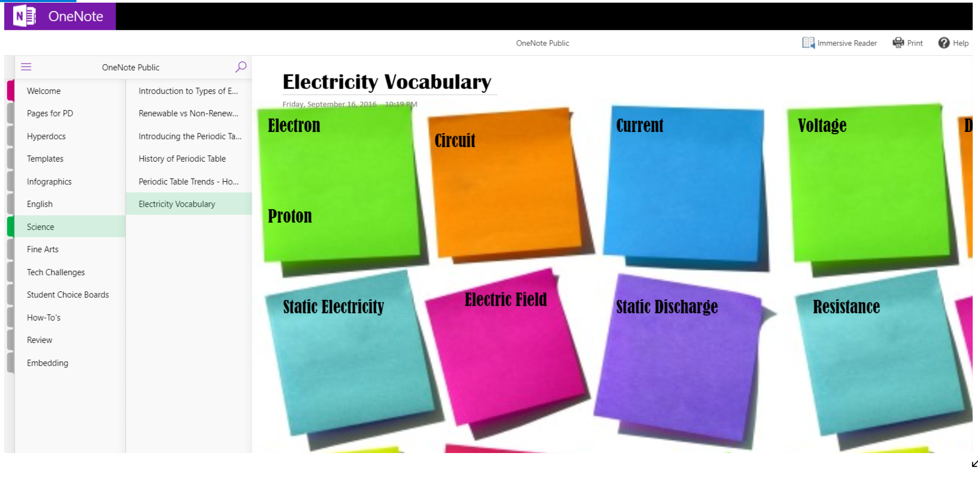
Organizing Information

Slide 19
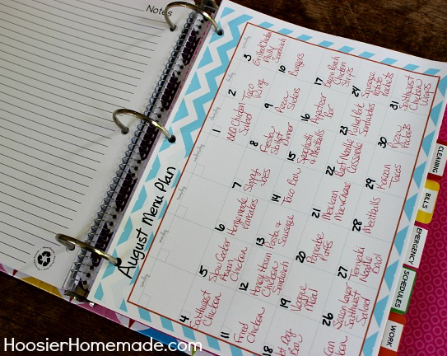

Slide 20
Supporting Students with Disabilities
Assignment | Strategies
Reading a PowerPoint/classroom notes and answering questions | 1. Create Voiceover PowerPoint 2. Copy and Paste Text into word and use immersive reader. 3. Spot Dot Divide Strategy
Writing assignment (notes, lab, write a paragraph) | Use Microsoft word features (dictate, text suggestions, and comment feature).
Note-taking | Immersive Reader (Read-to) Feature Color Coding/Highlighting
Watching a demonstration video/lab (how to do a math problem) | Provide a checklist
Inferencing | Visuals with questions

Slide 21
Specialized Teaching & Learning
@cobbspecialized
@mellummis98
This Photo by Unknown Author is licensed under CC BY-SA-NC

